Slide 1
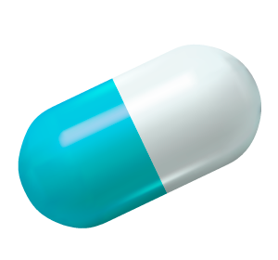


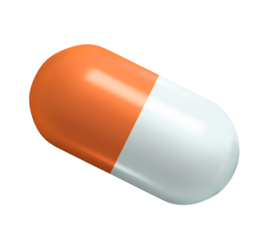
CardioGuard
Where technology meets care
GROUP 03
CO227
Notes:
Good morning everyone! We’re grup 03 CO227. We’re here to present you about CardioGuard - Where technology meets care!

Slide 2
Table of contents
Introduction
Core Functionality
Demonstration
01
02
03
Deployment
Testing and Progress
04
Timeline and Q&A
05
Code Quality
06
A brief description
What our System is about
How our system works
Testing phases we deployed
A brief description
How we came together

Slide 3




Introduction
Thushara
Doctor Namal
Thushara
Hospital
Notes:
So , I’ll introduce you to our system CardioGuard! What is cardio Guard actually ?
Well, cardioguard is a Cardiac patient , or as commonly known heart patient record management system
It is for the use of hospital and medical centers.
There is also a prediction system to determine whether a patient might have the risk of a heart disease
This is for doctor’s use only.
Also our system deploys a unique interface for the patients as they can view a certain amount of their data and their doctor’s reccomentations
This provides the doctors the ability to get the patient’s previous data in a case where the patient have been in the care of the facility

Slide 4



What is
CardioGuard ?
Cardiac patient record system
Embedded prediction System for doctors
Interface for patients
Easier access for doctors to patient data
Notes:
So , I’ll introduce you to our system CardioGuard! What is cardio Guard actually ?
Well, cardioguard is a Cardiac patient , or as commonly known heart patient record management system
It is for the use of hospital and medical centers.
There is also a prediction system to determine whether a patient might have the risk of a heart disease
This is for doctor’s use only.
Also our system deploys a unique interface for the patients as they can view a certain amount of their data and their doctor’s reccomentations
This provides the doctors the ability to get the patient’s previous data in a case where the patient have been in the care of the facility

Slide 5
Our Target
2
4
1
3
To give the doctors and patients a digital experience for easier and better health care

Slide 6

02
Core Functionality
Demonstration
How our system Works

Slide 7
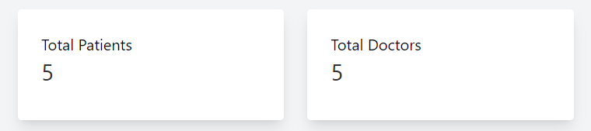
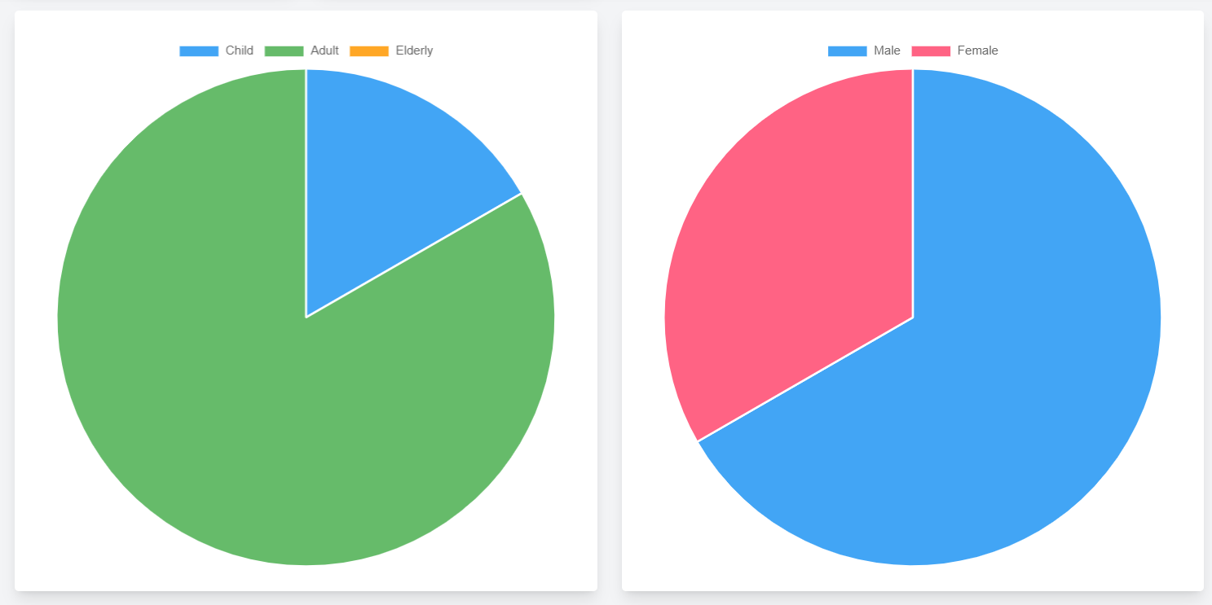
Admin Functionalities
View the age groups and gender variety
See the amount of patients and doctors registered to the system
Gender variation
Age groups

Slide 8
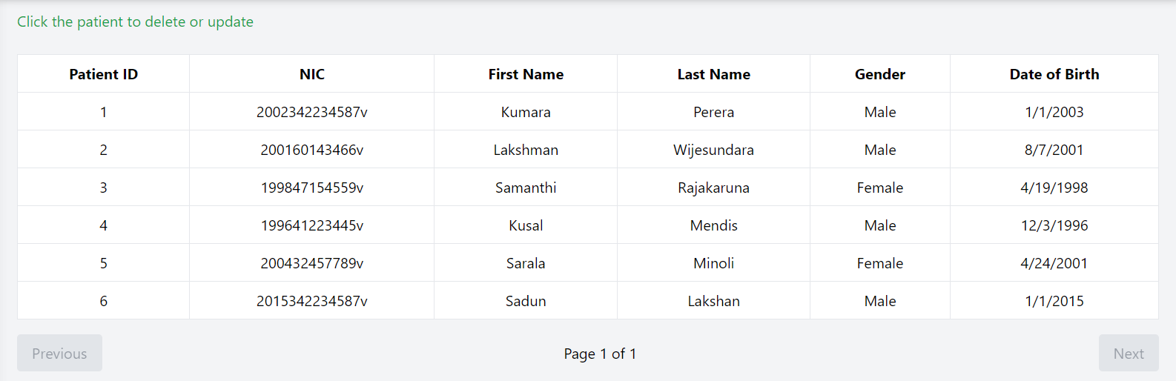
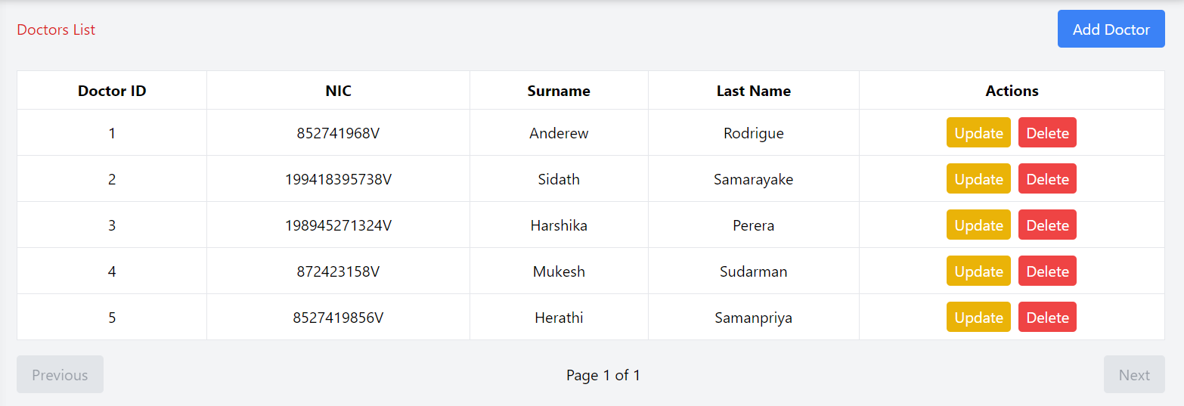
Get the details of patients with their name,NIC or their PatientID
Get the details of doctors with their name,NIC or their DoctorID
List of patients
List of doctors

Slide 9
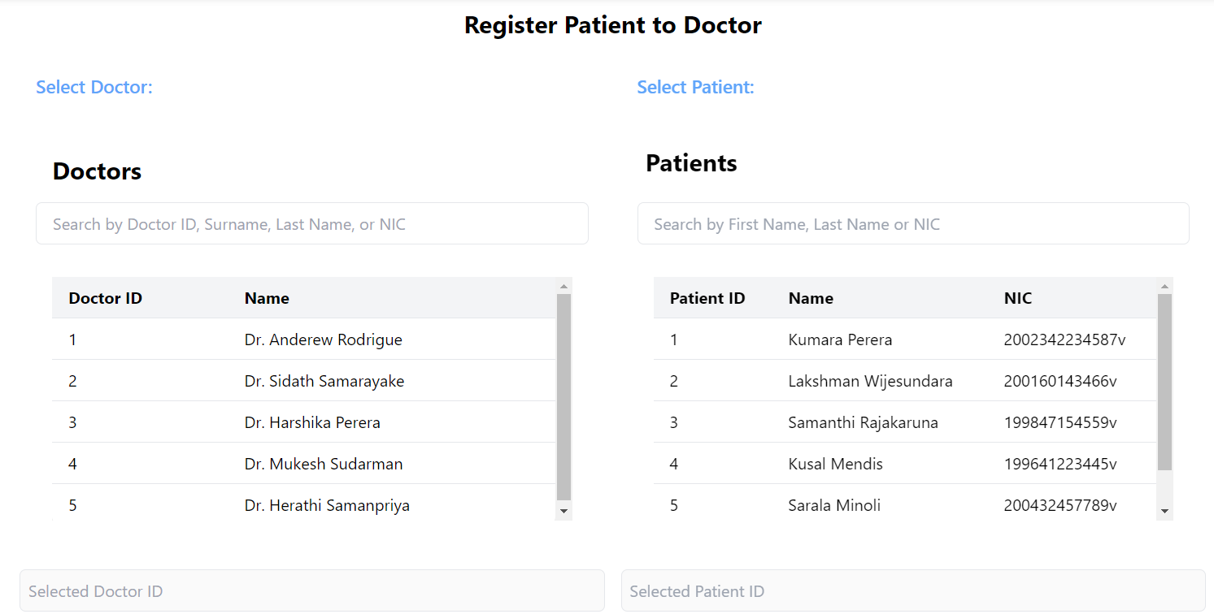
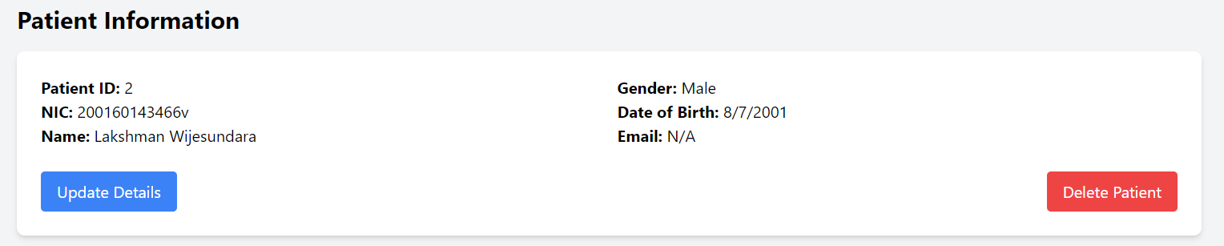
Register a patient to a certain doctor
Add , update or delete a patient record
Add, update or delete a doctor’s record
Select a patient
Select a doctor

Slide 10
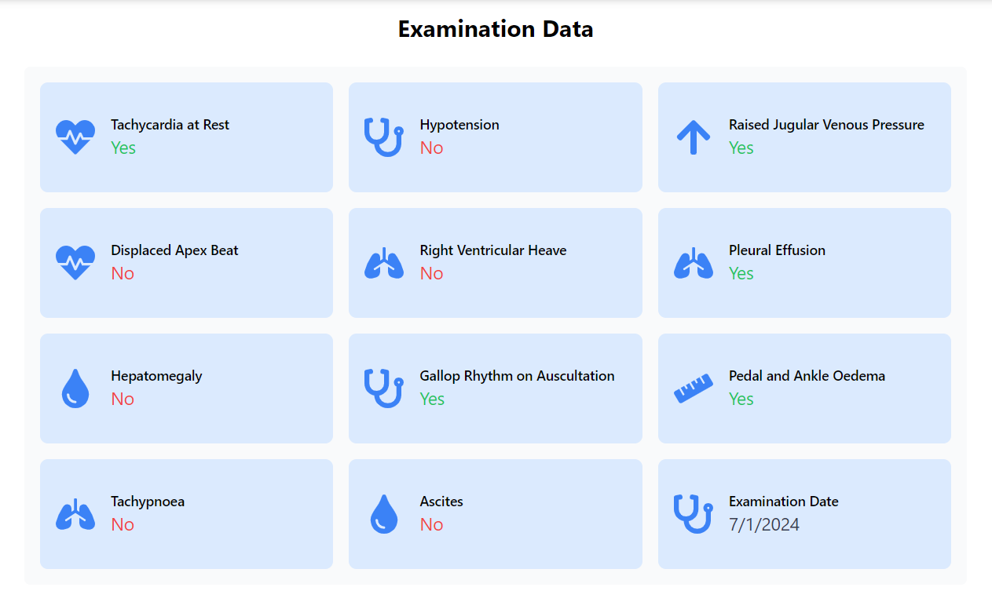
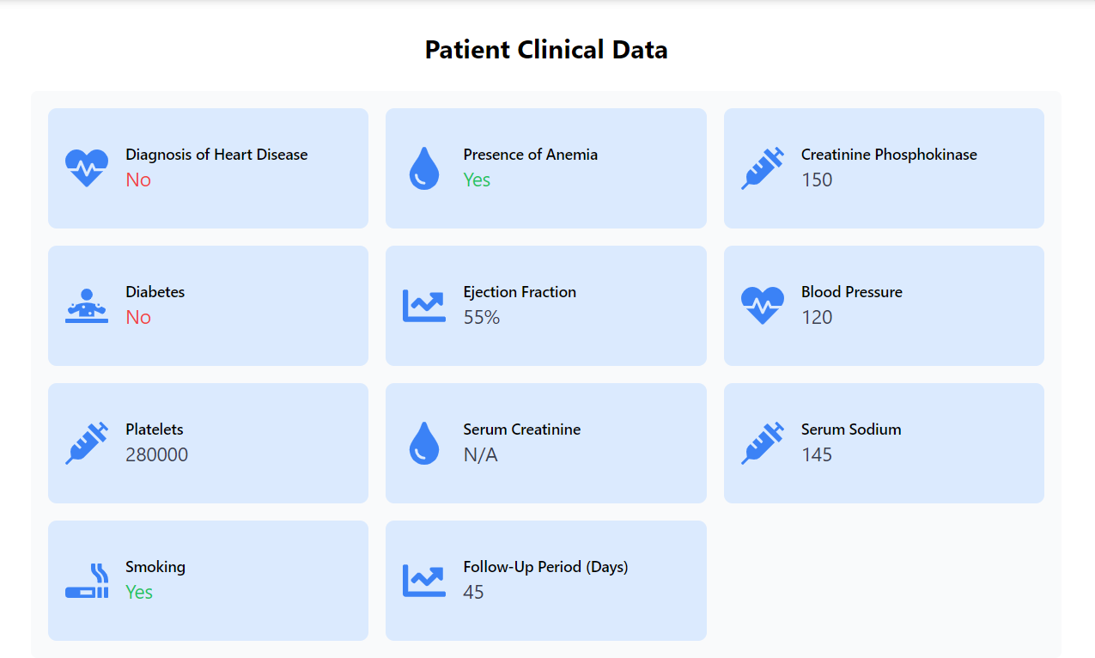
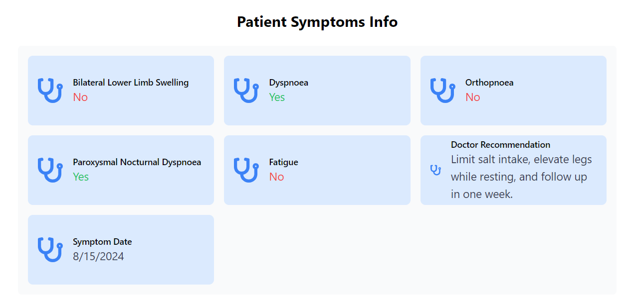
View patient’s medical details

Slide 11
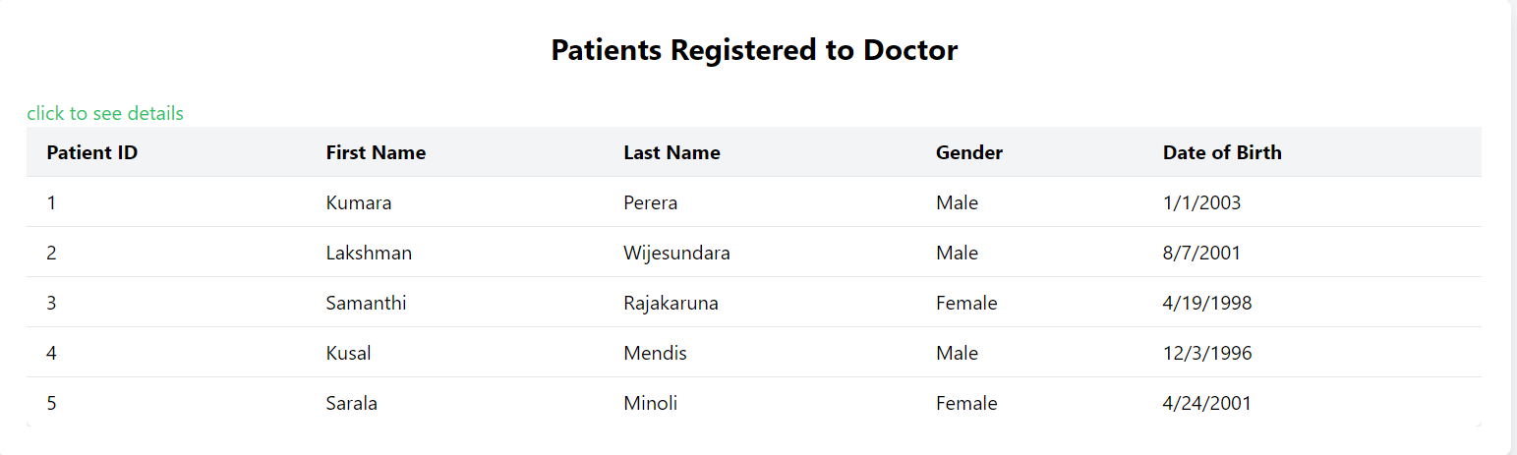
Doctor Functionalities
Doctors can view all the patients but cannot access all the patient data
Access only patients registered under their ID

Slide 12
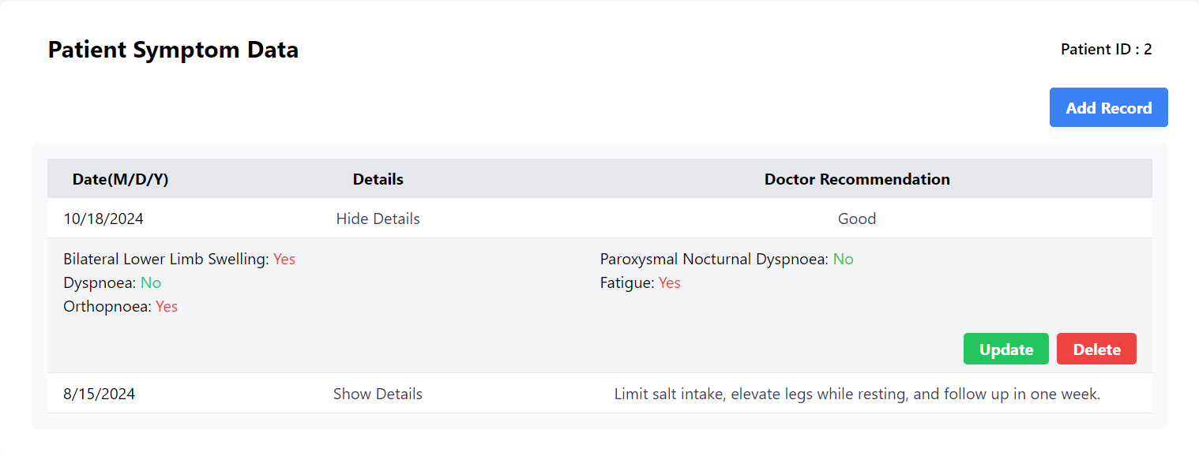
Access the data of the patients , add new records, change patient data and delete records. Also, doctors can access previous interactions through the systems
Doctors can access past Clinical data records and admissions information same as above shown
Add records
Update/delete records

Slide 13
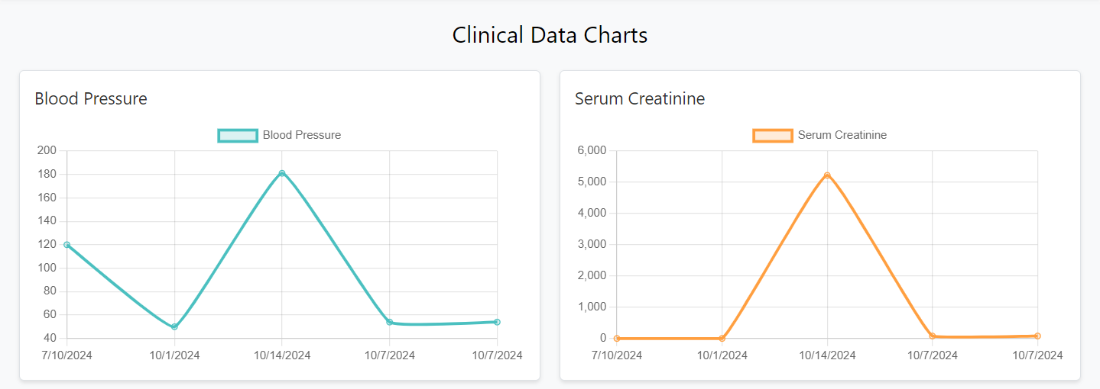
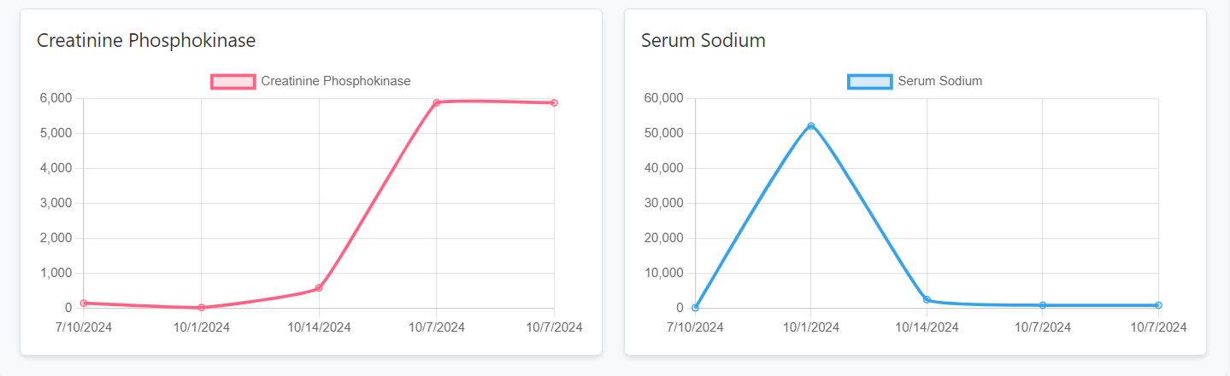
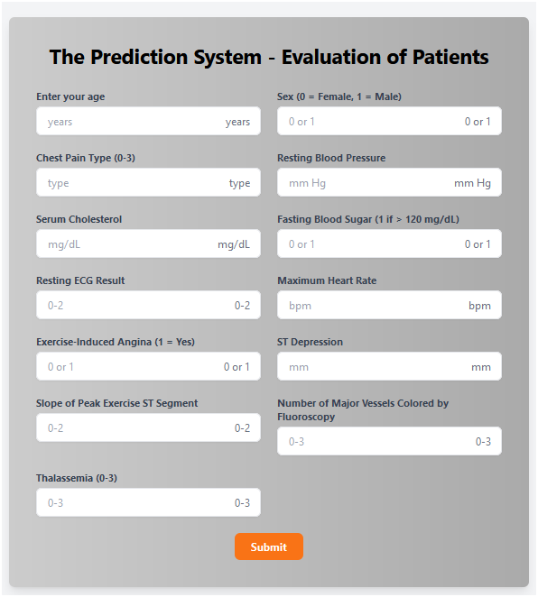
Doctors can see visual data representation through charts and graphs
Doctors can use prediction system to enhance their medical opinions
How each clinical data varies day by day

Slide 14
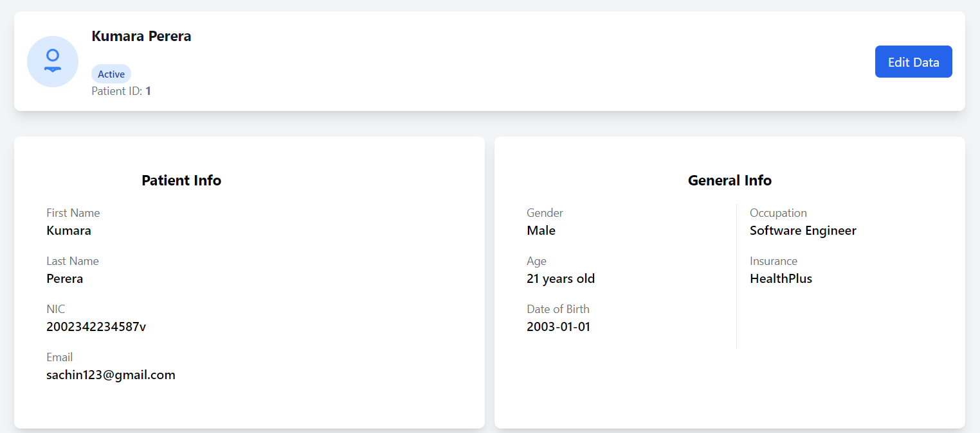
Patient Functionalities
Patient Can edit some of his data [ex: Email , Phone number]
Can view their personal data
Edit data
View their own personal data

Slide 15
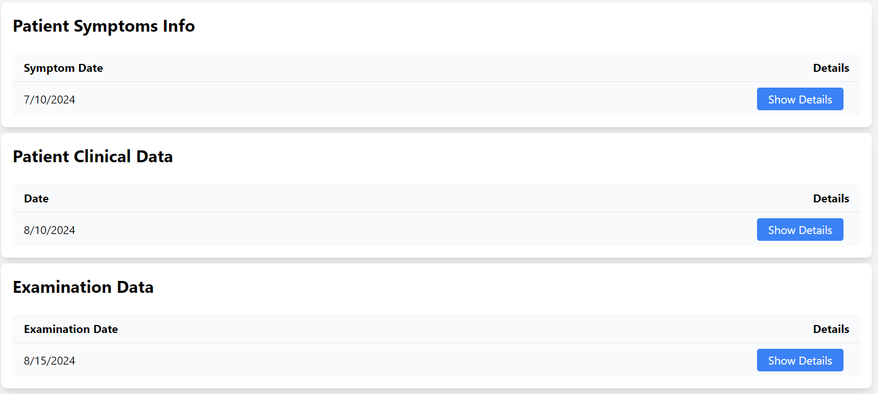
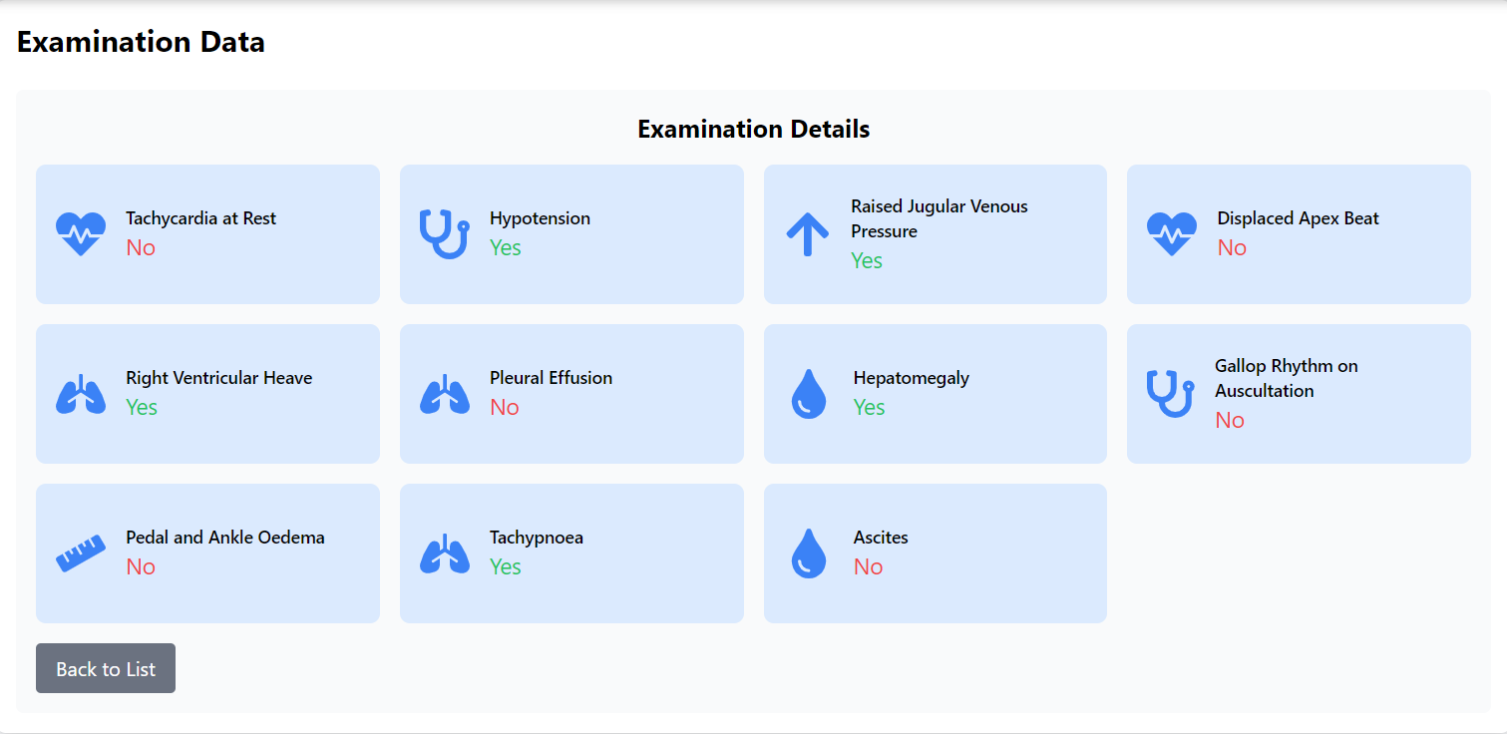
Patients can view their medical data
.
Once clicking show details

Slide 16
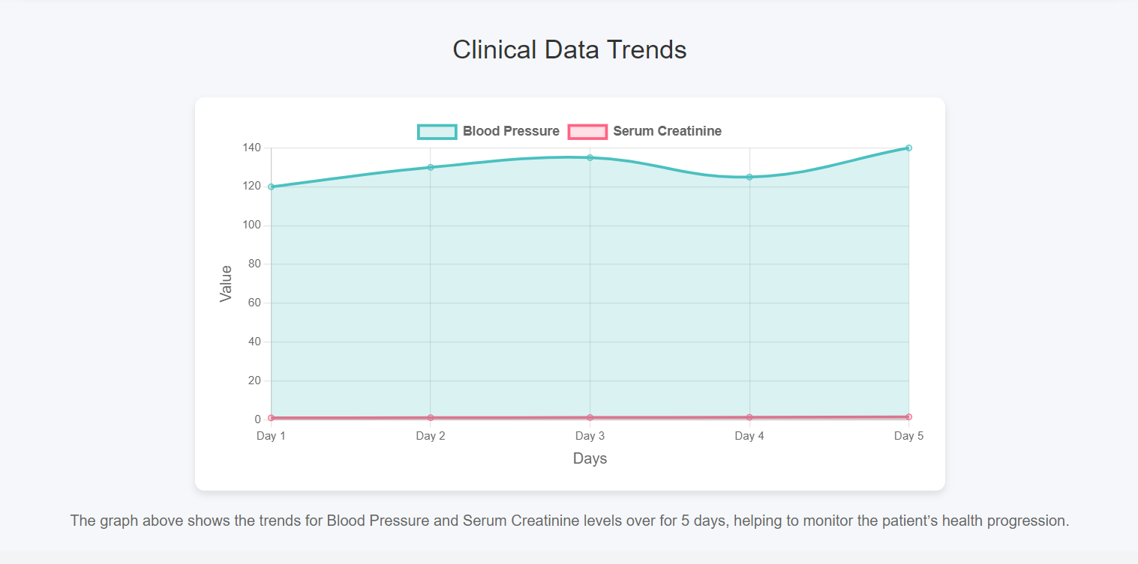
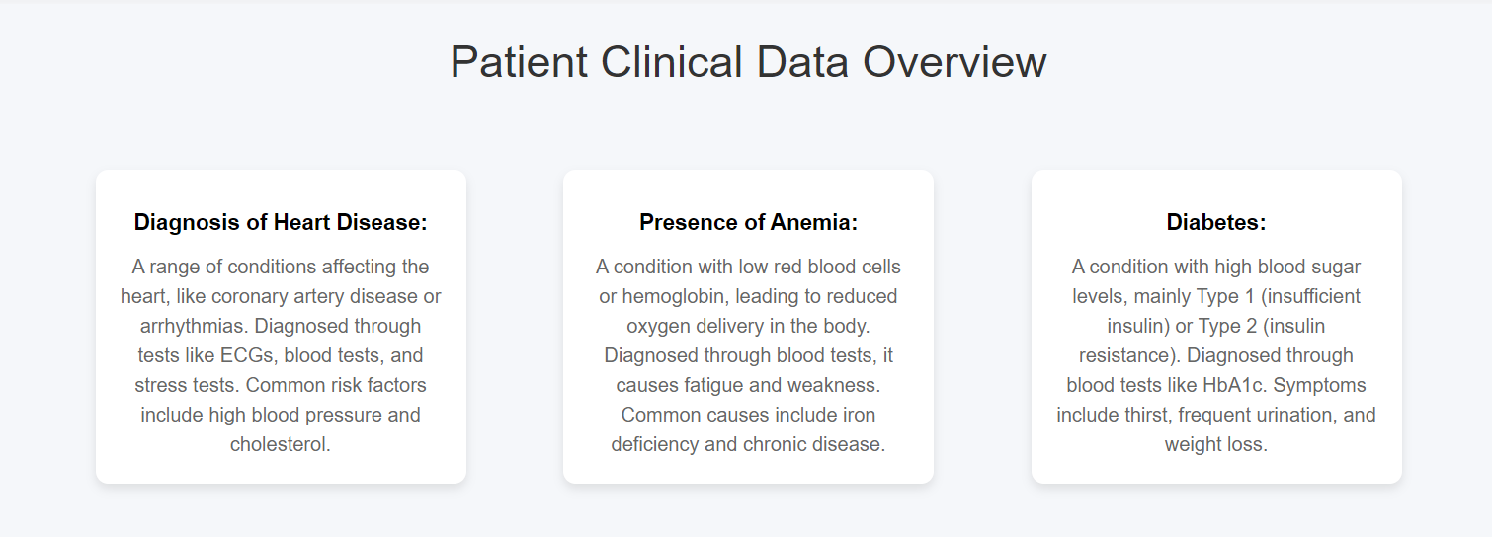
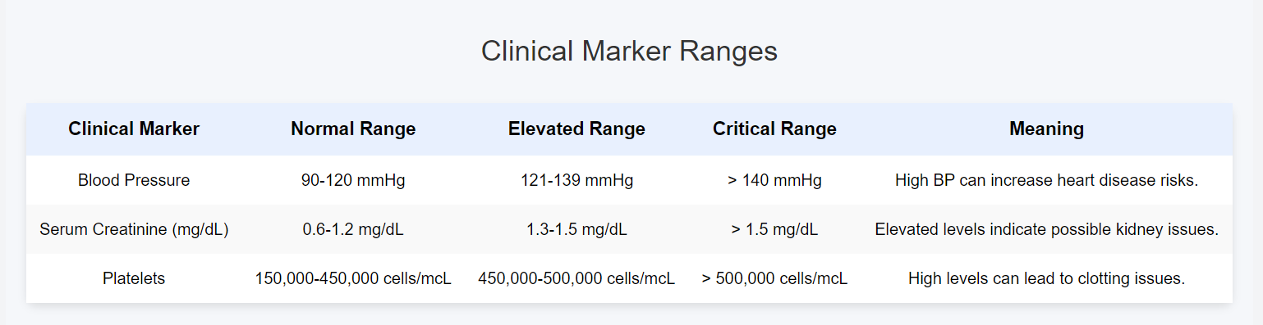
Clinical data overview is provided
They can reach out though the services page if required
Critical levels of clinical data

Slide 17
03
Demonstration
How our system Works

Slide 18
Live Demonstration
How our
system works

Slide 19
04
Testing and Progress

Slide 20
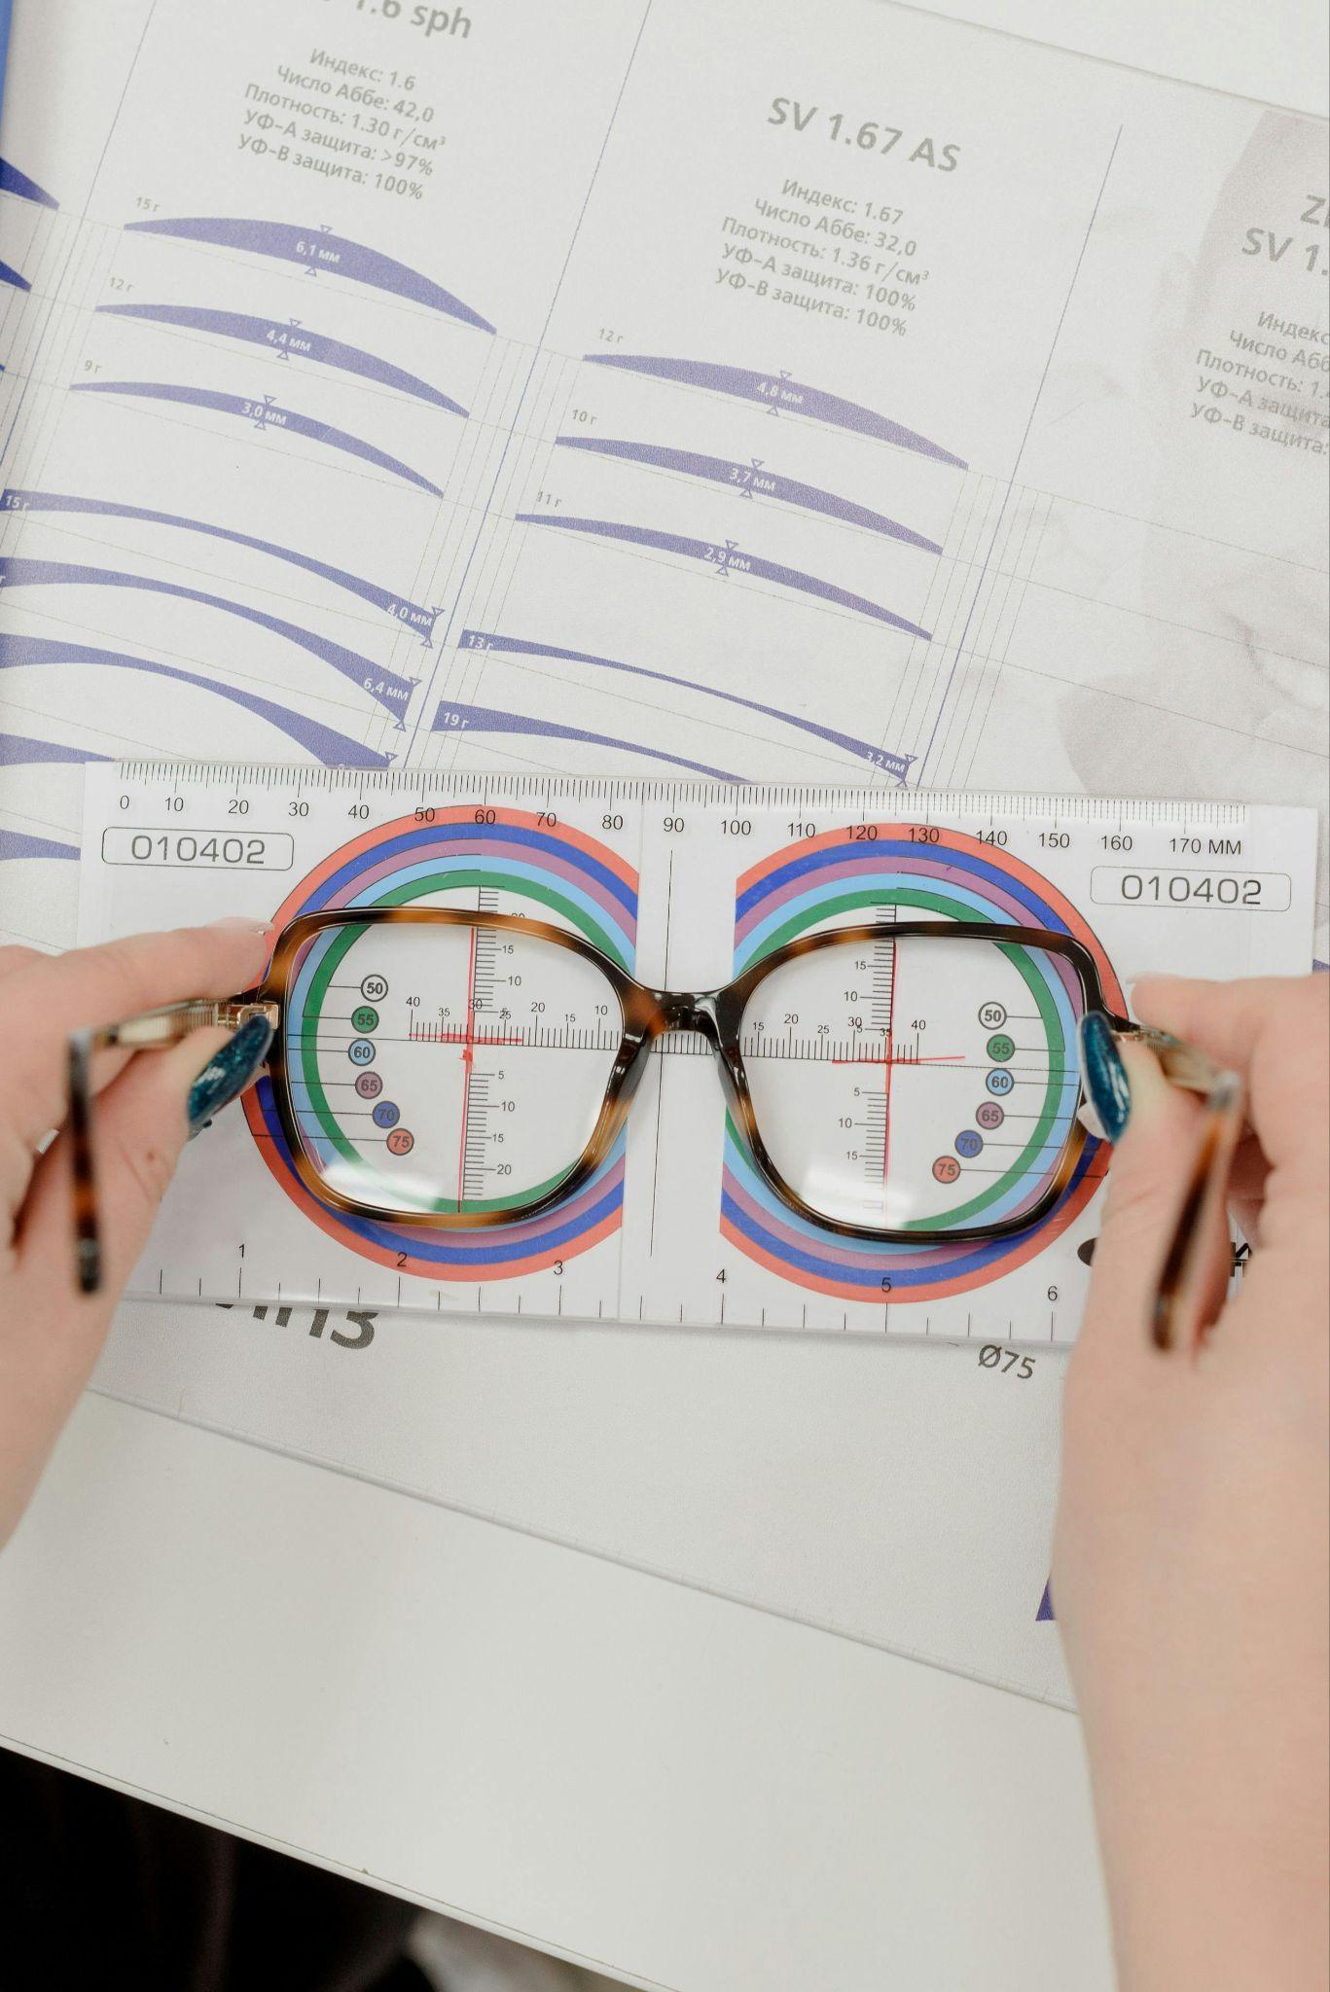
Testing and bug fixing
Unit Testing - Frameworks,PostMan
Integrated Testing
Regression Testing
Notes:
We have the unique tested on components specially in react and in the machine learning chord then interfere test on the system for the earn when we are implementing more and more functionalities feed the regression testing to see whether this compounds are classing or not and also functional testing to test the functions as well used automatic testing in the front end to verify the lock being and checking password to improve more on the Machine learning code and its accuracy we have also implemented a confusion matrix which provided over 85% accuracy and precision With the guides of our supervisor We could interact with Dr. Upul and with an engineer who gave his perspective as an outside user to test the functionality of the system

Slide 21
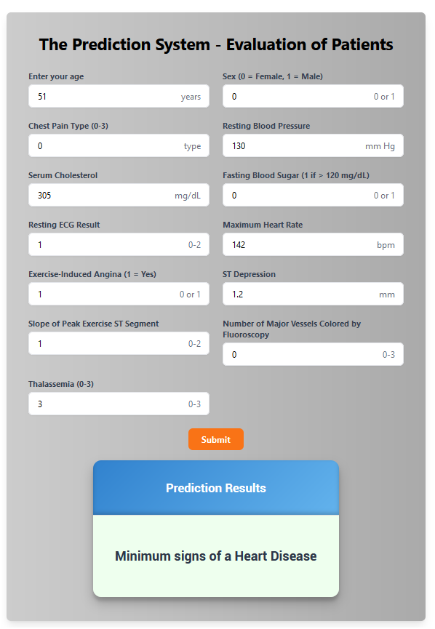
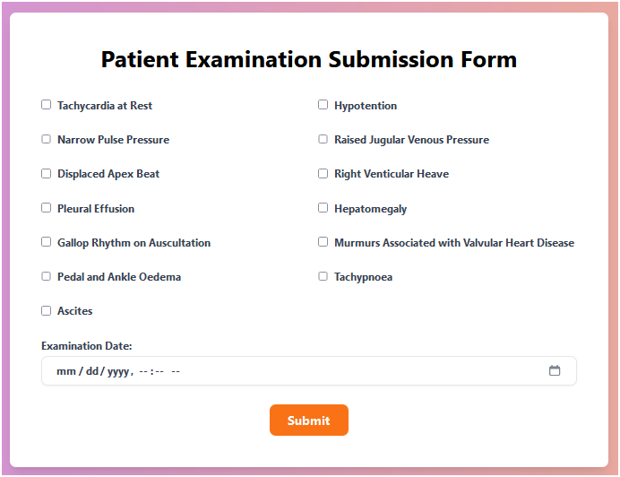
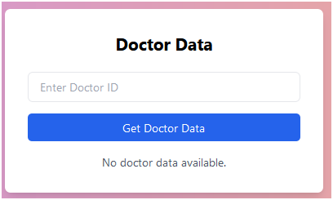
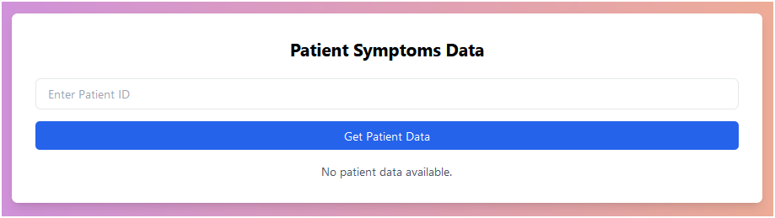

Slide 22
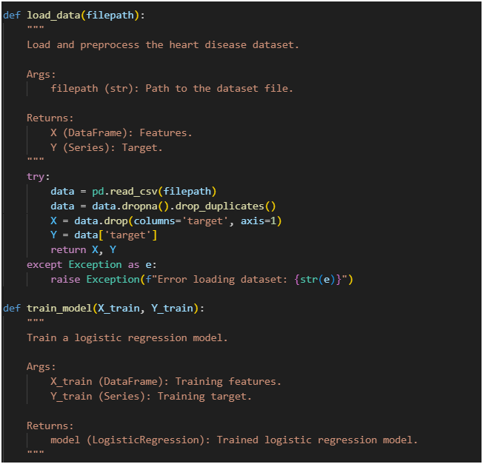
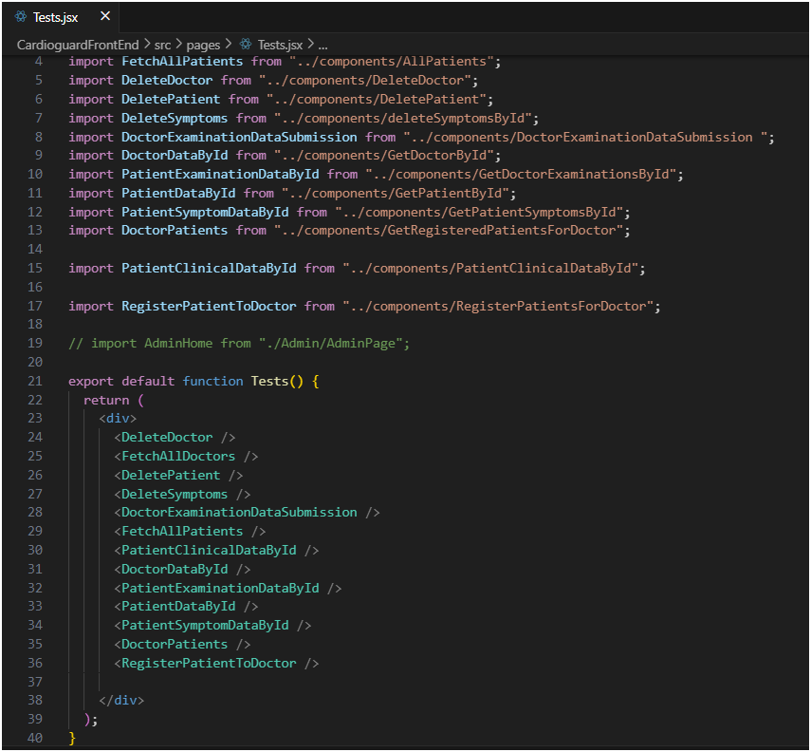

Slide 23
Testing and bug fixing
Unit Testing - React , ML , Functional
Integrated Testing
Regression Testing
Automated Testing - Login
Confusion Matrix - For machine learning
Notes:
We have the unique tested on components specially in react and in the machine learning chord then interfere test on the system for the earn when we are implementing more and more functionalities feed the regression testing to see whether this compounds are classing or not and also functional testing to test the functions as well used automatic testing in the front end to verify the lock being and checking password to improve more on the Machine learning code and its accuracy we have also implemented a confusion matrix which provided over 85% accuracy and precision With the guides of our supervisor We could interact with Dr. Upul and with an engineer who gave his perspective as an outside user to test the functionality of the system

Slide 24
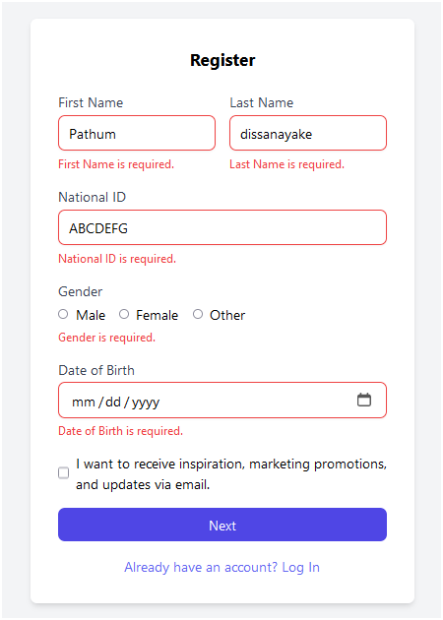
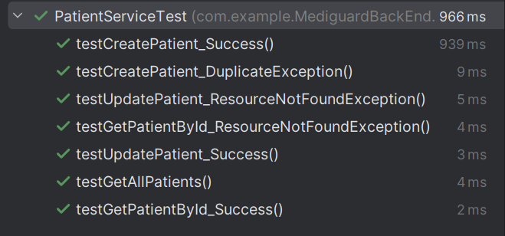
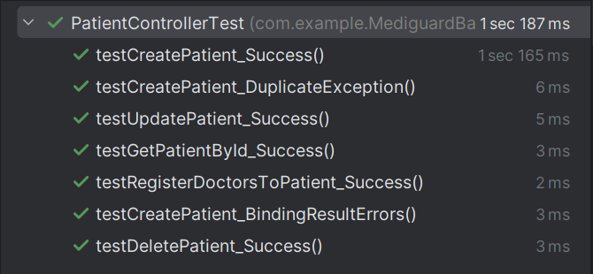
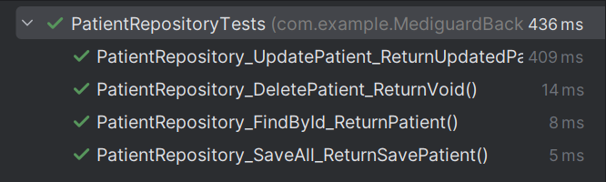

Slide 25
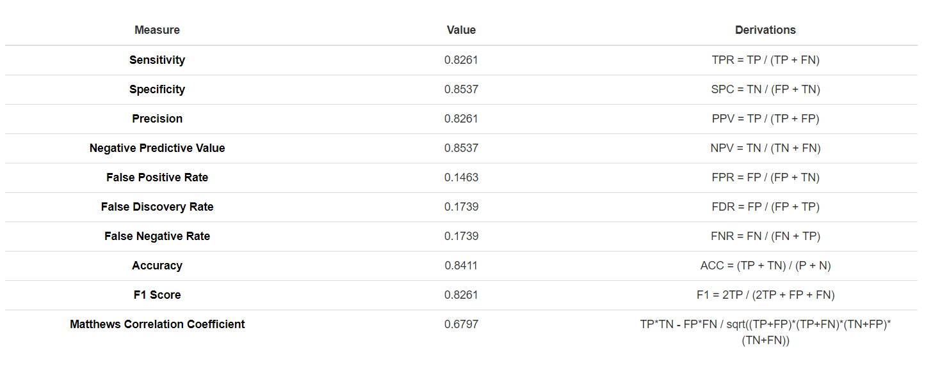
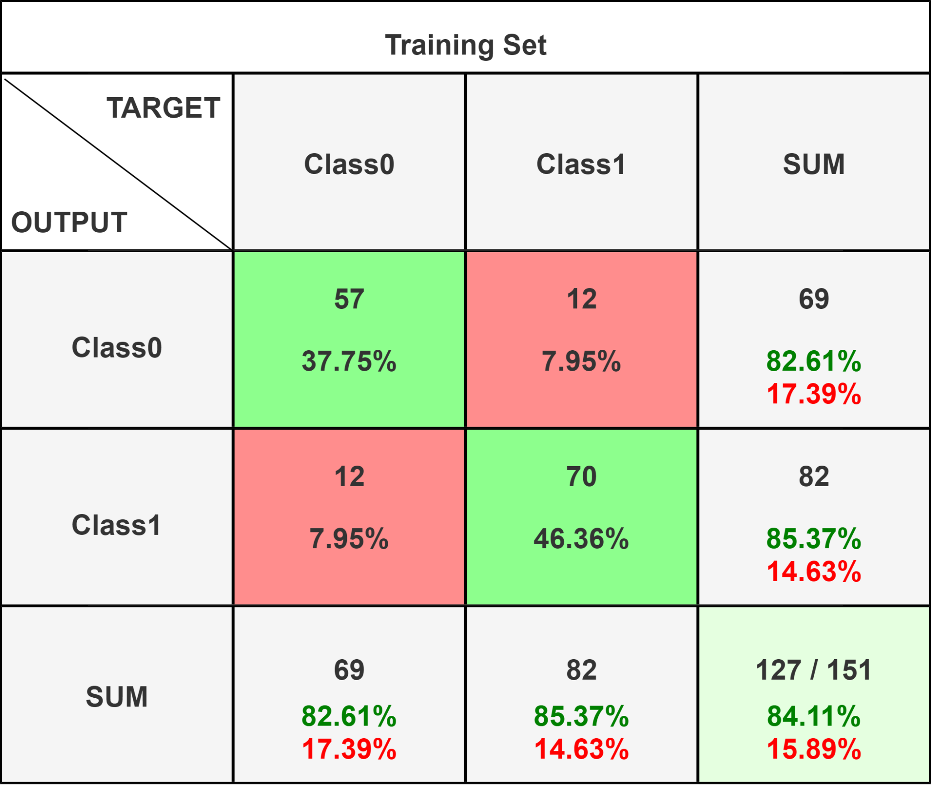

Slide 26
Testing and bug fixing
Unit Testing - React , ML , Functional
Integrated Testing
Regression Testing
Automated Testing - Login
Confusion Matrix - For machine learning
UI Testing
Mocks
Stubs
Fakes
BlackBox Tesitng
WhiteBox Testing
Notes:
We have the unique tested on components specially in react and in the machine learning chord then interfere test on the system for the earn when we are implementing more and more functionalities feed the regression testing to see whether this compounds are classing or not and also functional testing to test the functions as well used automatic testing in the front end to verify the lock being and checking password to improve more on the Machine learning code and its accuracy we have also implemented a confusion matrix which provided over 85% accuracy and precision With the guides of our supervisor We could interact with Dr. Upul and with an engineer who gave his perspective as an outside user to test the functionality of the system

Slide 27
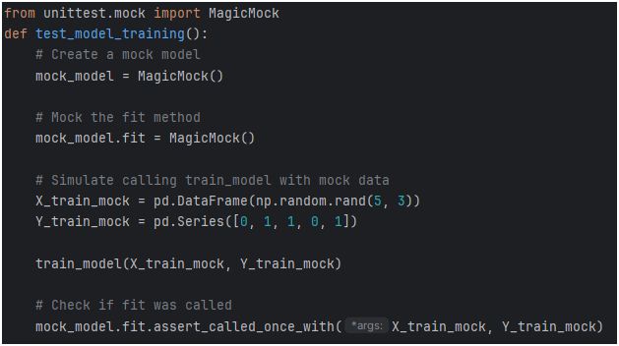
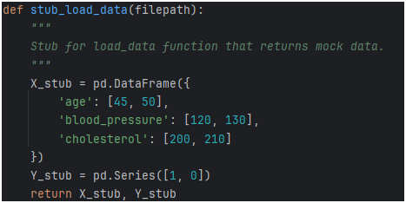

Slide 28
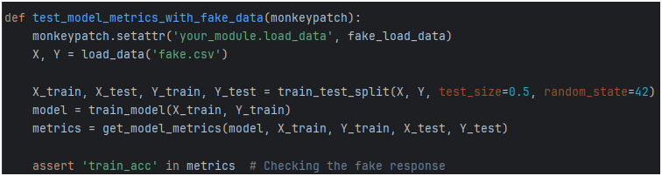
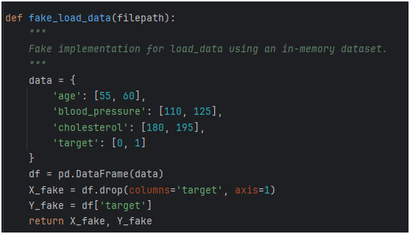

Slide 29
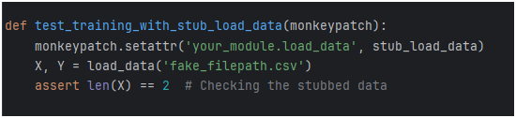
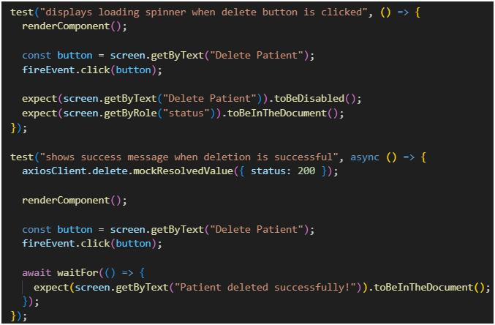

Slide 30
05
Code quality &
Design principles

Slide 31
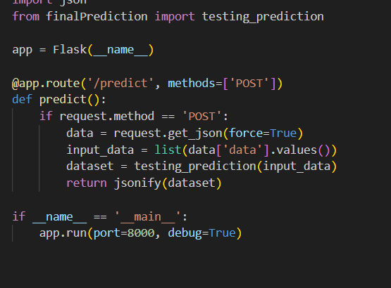
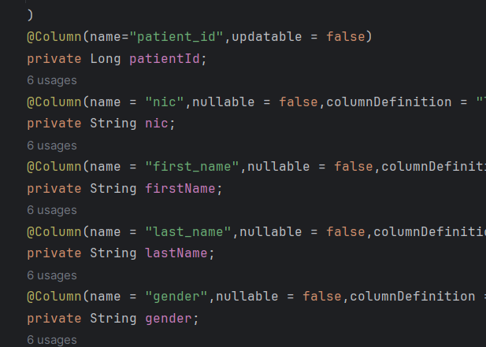
Coding Style
Readability

Slide 32
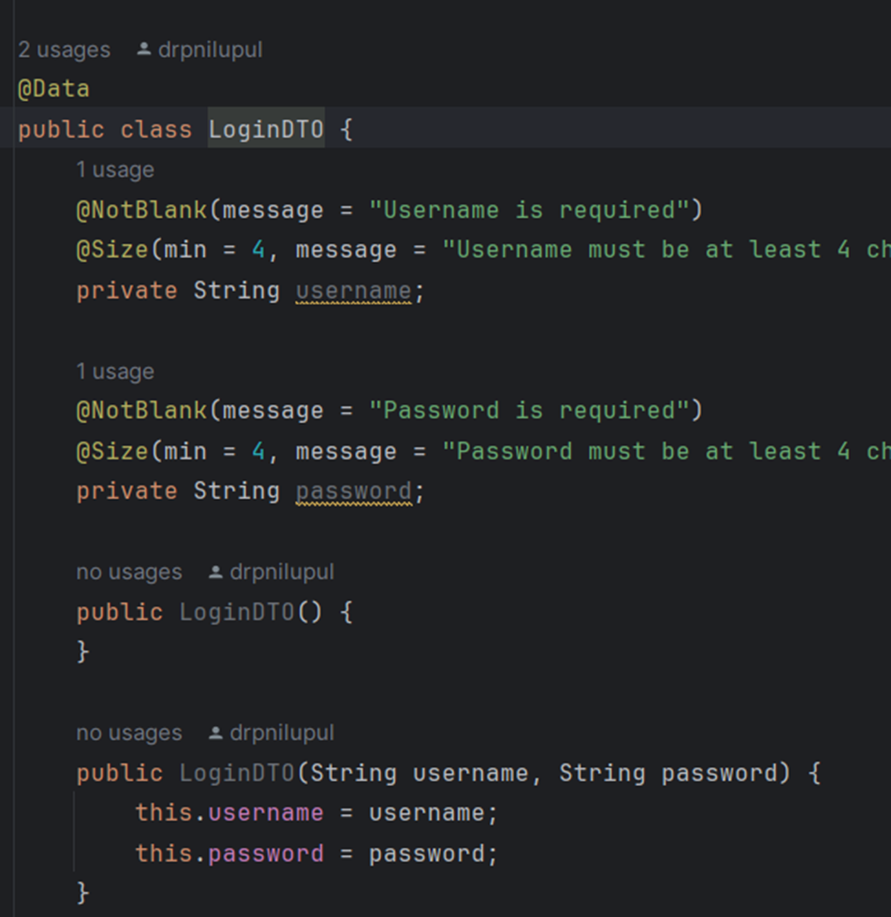
Consistency

Slide 33
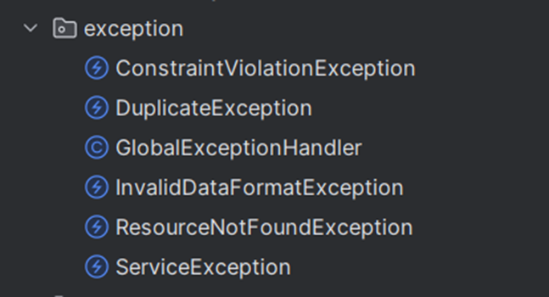
Error handling

Slide 34
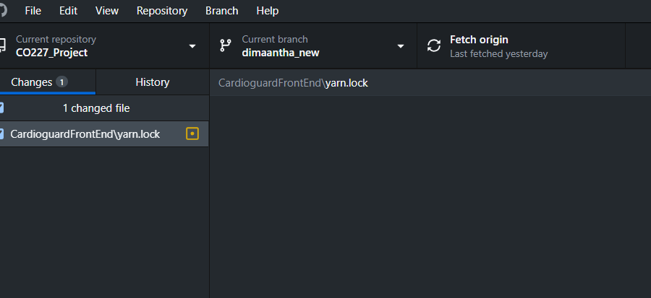
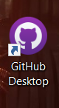
Refactoring

Slide 35
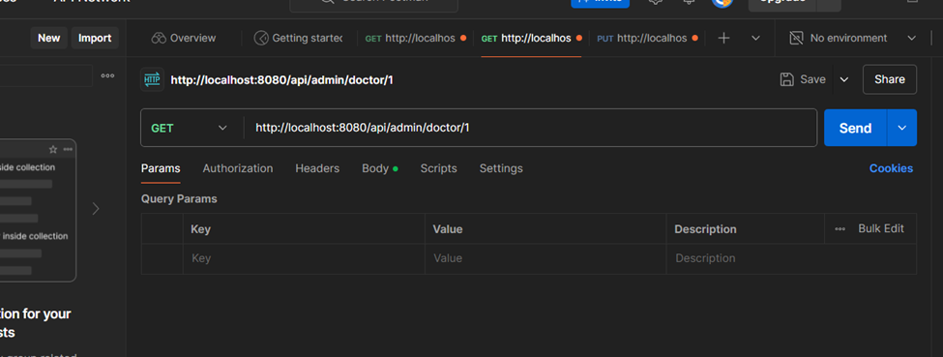
Testing

Slide 36
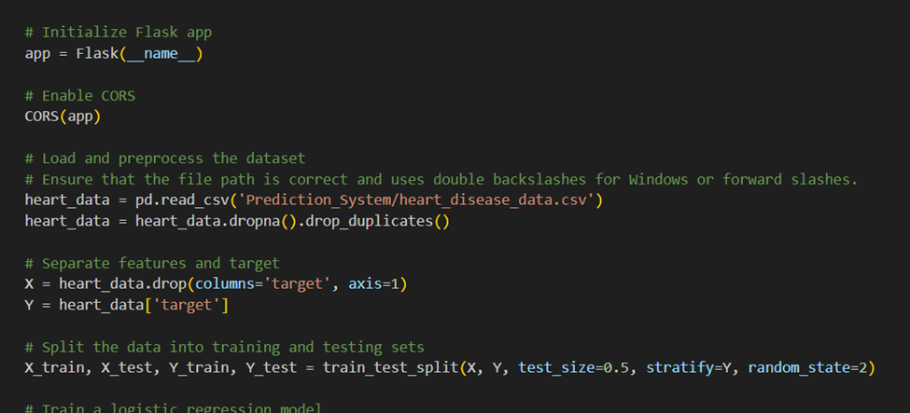
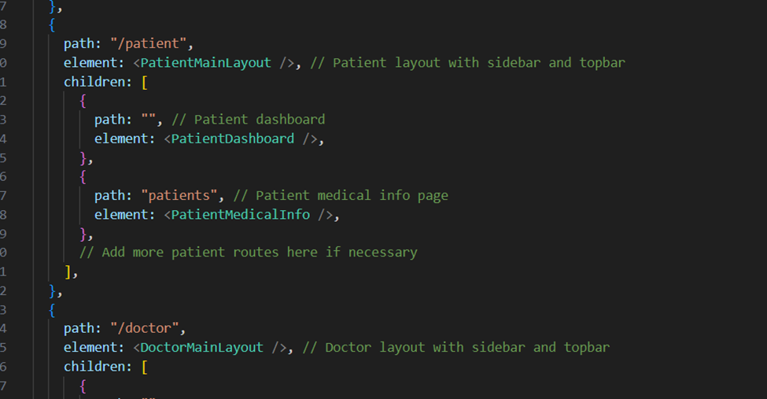
Comments
Essential for collaboration and future developments.

Slide 37

Extensions & Tools
We used tailwind(React) for our frontend.

Slide 38

We used java with spring boot framework for our backend.

Slide 39

The ML part is done by python

Slide 40
Deployment
We have not deployed our system
Why ?
With the Guidance of the supervisors
Dr. Damayanthi
Dr. Upul Jayasinghe
We have been granted the opportunity to work with Engineer Dushan , WSO2 engineer, who wants to further improve our system for kidney patients and connect this system to the national hospital system.

Slide 41
Deployment
How Do we Deploy our system
Where ?
Front End
AWS S3 + CloudFront for static hosting
BackEnd and Python prediction
Heroku
DataBase
AWS RDS or Heroku
Since this is going to funded, we have thought of using these for the deployment

Slide 42
06
Progress and TimeLine

Slide 43
Progress Vs Milestones
80% +
Oct 14th
100%
Today
Sep 18
We had implemented more than 80% of work
We finalized the system testing phases and system documentation
We are well within our time line and all the members are giving their full dedication
Notes:
With regards water progress is so far We have finished more than 80% were and we will try to complete a whole system before 6th of October our team members are giving the 100% in this project .So far we have some authentication to finalize and Piston graph from the machine learning code finalise the UA pages and final of the dashboards and finally test the whole system as a whole.

Slide 44
Milestones Accomplished
SEP
18
SEP
22
SEP
26
OCT
20
80%
85-90 %
95%
99%
First Evaluation
Of CO227
[REACHED]
Finishing the dashboards and UI
Pages and finalizing all the functionalities
[REACHED]
Finishing importing required graphs and finishing styling the system
[REACHED]
Testing the system and hosting the system.Getting user acceptance and finalizing the rest
[REACHED]

Slide 45


Slide 46
Thank You !
Any Questions ?

